Slide 1

Denton County Juvenile Detention Center
Joe Dale Sparks Campus
We strive to create a safe, positive, and nurturing learning environment where all students can succeed.

Slide 2
WHAT IS JOE DALE SPARKS?
The Joe Dale Sparks Campus is for students - who have encountered legal and/or disciplinary issues - to continue their education. The school operates as part of the Denton County Juvenile Detention System and serves all students in Denton County. The school is named after Joe Dale Sparks, a former Denton ISD teacher.
Sparks prides itself on its ability to reach these students at their most vulnerable state and work with them to receive the highest education possible while they are away from the natural class setting.
Students at Sparks are taught by certified teachers employed by Denton ISD, but eventually return to their home campuses throughout Denton County - once their legal and/or disciplinary issues are resolved. During their time at the school, these students are able to participate in coursework assigned from their respective schools.
The goal of the teachers and administrators at Sparks is to create a positive and nurturing environment for its students while making sure they follow the necessary guidelines and procedures of the county detention center. Sparks staff will work to ensure these students have the opportunity to earn school credit and maintain a pace toward their high school graduation.
Established: Named Joe Dale Sparks Campus 14 years ago
Mascot: Spartans
Colors: Navy Blue and Gold
Our Mission: The Faculty and staff of the Joe Dale Sparks Campus will strive to create a safe, positive, and nurturing learning environment where all students can succeed.

Slide 3
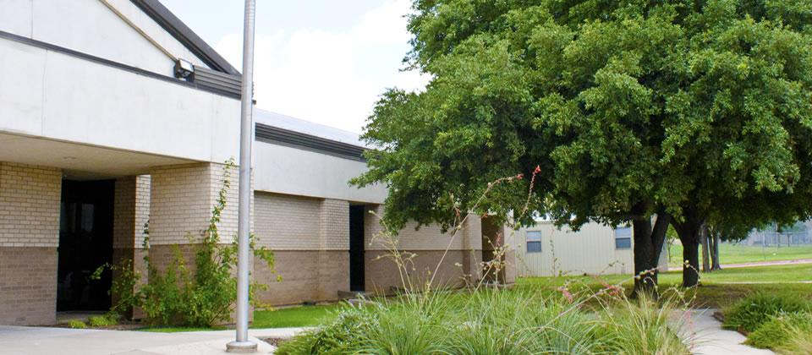
Denton County Juvenile Detention

Slide 4
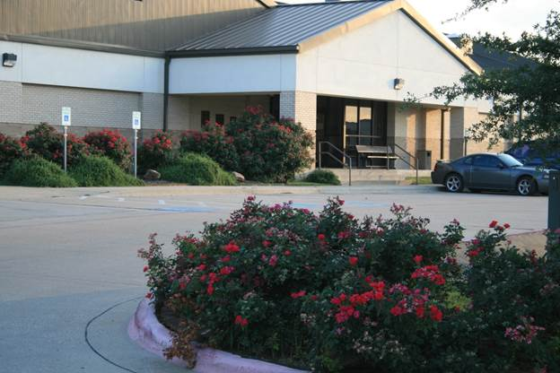
Joe Dale Sparks Campus Entrance

Slide 5
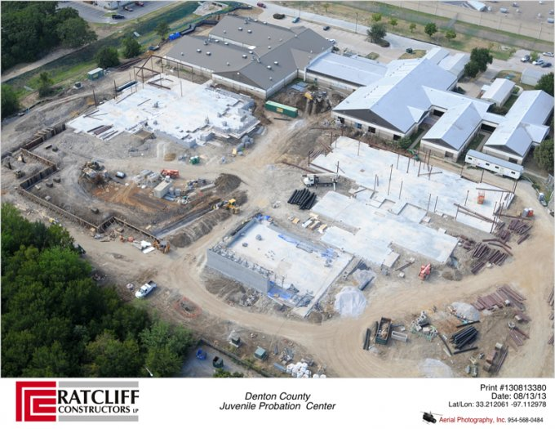
New Construction

Slide 6
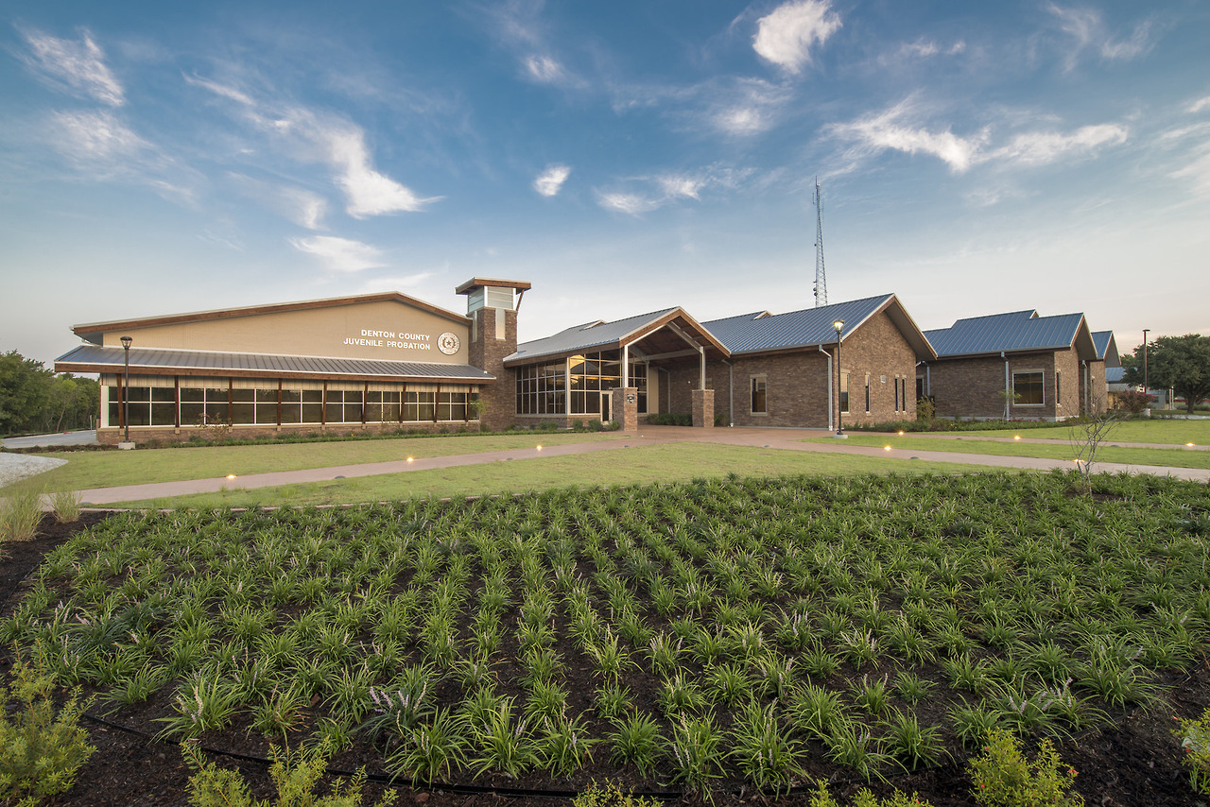
Notes:
NEW CONSTRUCTION COMPLETED

Slide 7
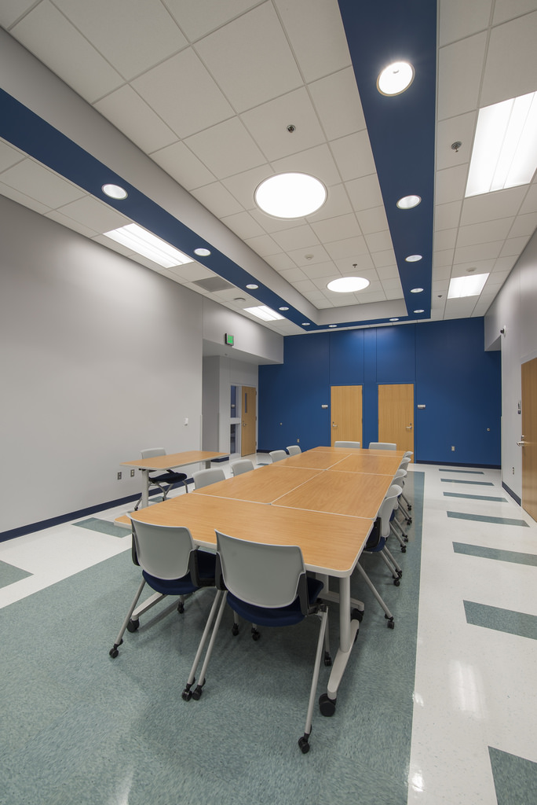
Notes:
NEW POST- ADJUDICATION JOE DALE SPARKS CAMPUS WING

Slide 8
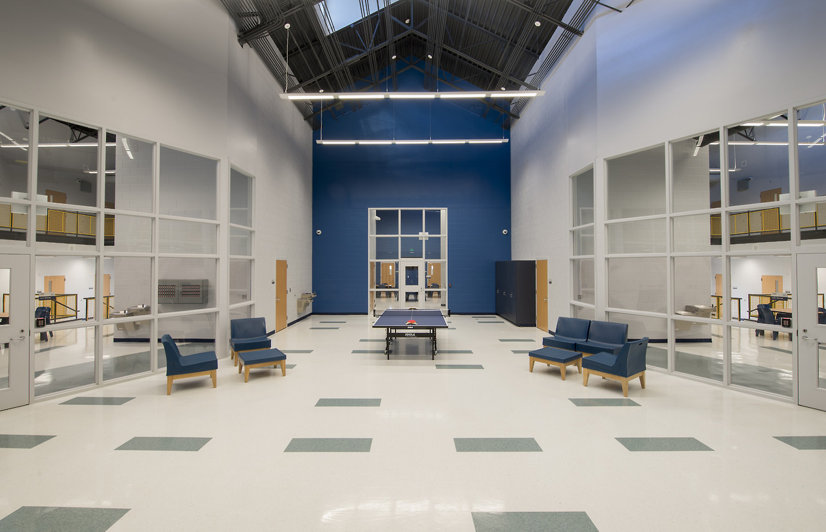
Notes:
NEW POST-ADJUDICATION STUDENT LIVING SECTIONS

Slide 9
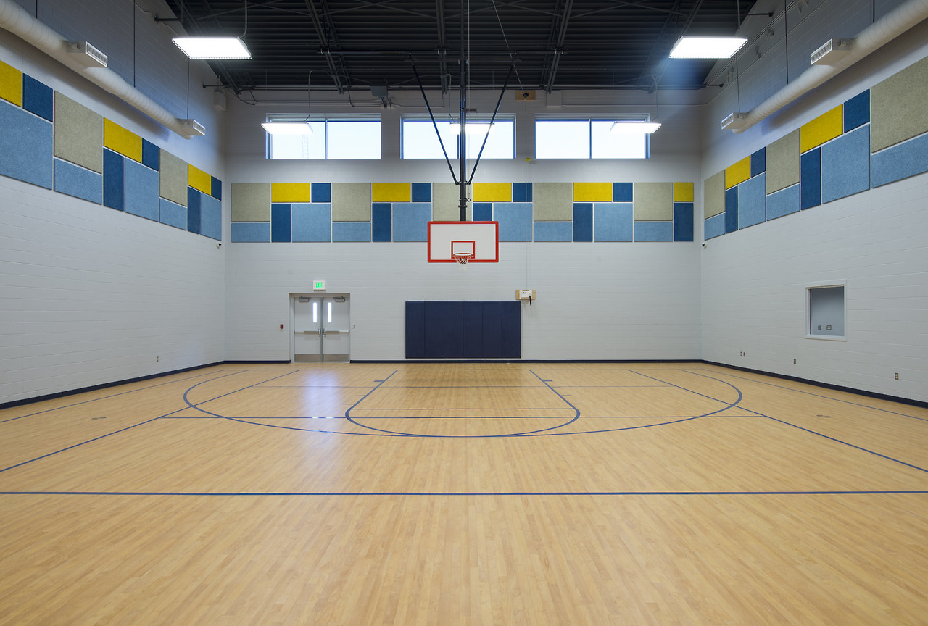
Notes:
NEW POST-ADJUDICATION AND JJAEP GYMNASIUM AND CAFETORIUM

Slide 10
Denton County Juvenile Detention Facility
Sparks Campus
P.O.S.T.
Post-Adjudication Program (Long-Term)
Section J - Boys
Section K - Girls
Detention
Pre-Adjudication Program (Short-Term)
Section C - Boys
Section L - Boys
Section D - Boys
Section F - Boys
Section G - Girls

Slide 11

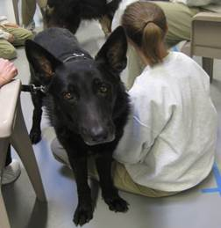
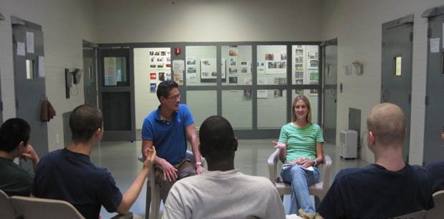
76 secure individual rooms with the ability to authorize more rooms if the need arises. The rooms include separate sections for boys and girls.
A day area configured for each section
Two indoor gyms and cafeteria’s
A library
Counseling areas
Classrooms
Indoor and Outdoor recreation areas

Slide 12
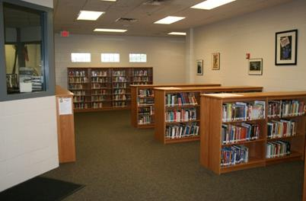
Notes:
JOE DALE SPARKS LIBRARY

Slide 13
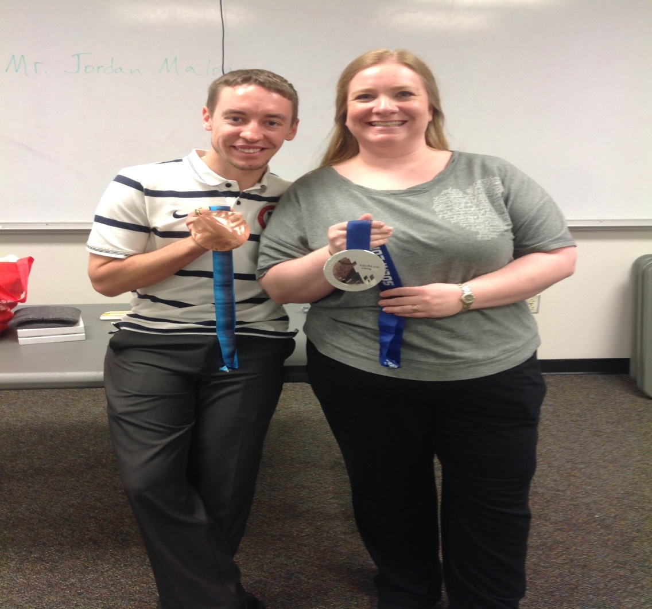
OLYMPIC HAPPENINGS

Slide 14
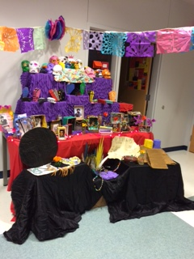
Notes:
STUDENT ART PROJECT

Slide 15
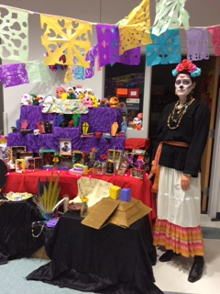
Sparks Art Class Display
Day of the Dead
Ms. Bourgeois

